Slide 1
CPS 109 - Lab 3

Slide 2
Agenda
1 - Exhaustive Enumeration
2 - Indexing Lists
3 - Iterating
4 - Binary Numbers

Slide 3
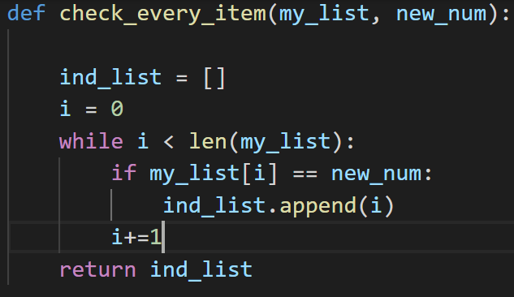
But First A Word on Functions
Short for “define”. Defines the function.
Function arguments. These are local variables.
Function name. This can be anything you want.
Return statement. Gives you a value to use later.

Slide 4
A Handy Definition
Exhaustive Enumeration:
Also known as “brute force” (most people call it this)
Simply means you search through/compute all possibilities/items in a list or set.

Slide 5
Indexing Lists
Remember how we went over loops last week? And we just talked about exhaustive enumeration? It’s handy in the context of indexing lists.
What’s an index? An index is the integer location of an item in a list or string.

Slide 6
Iterating
To iterate through something (usually a list or a string), you are simply accessing it by jumping from one index to the next.

Slide 7
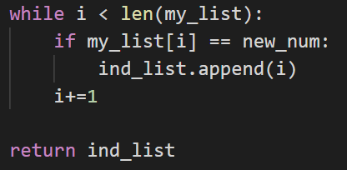
Example of Iterating/Indexing

Slide 8
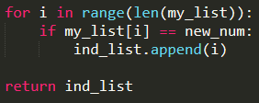
Prev. Example with “for” loop

Slide 9
Binary Numbers
Author’s Note: No one works with binary numbers in Python.
Binary numbers are representations of real numbers in base 2.
Side note: “Decimal” now refers to numbers in base 10.

Slide 10
Binary Numbers
You know those fancy numbers when they show computers on TV? 10101010… Those are binary numbers.
Converting between decimal and binary is pretty easy!

Slide 11
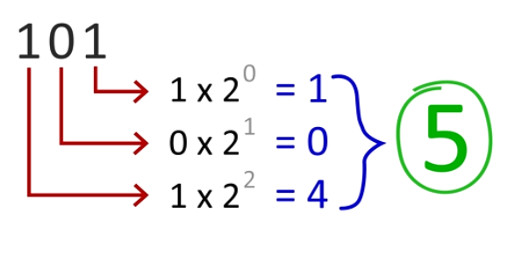
Binary Numbers

Slide 12
Binary Numbers
That last slide shows us how the 1s and 0s correspond with powers of 2. So, here is, essentially, how to count:
1 = 1
10 = 2
11 = 3
100 = 4
101 = 5
110 = 6

Slide 13
Binary Numbers Practice
Why don’t we try some examples together?
Decimal: 69
Binary:
Binary: 101
Decimal:
1
0
0
0
1
0
1
5
What’s the largest exponent of 2 that goes into 69?:
Binary: 111001
Decimal:
2**6
= 64 (Total: 64, Rem: 5)
57
What’s the next largest that goes into 5?:
2**0
+ 2**3
+ 2**4
+ 2**5
2**2
= 4 (Total: 64 + 4 = 68, Rem: 1)
=
1 + 8 + 16 + 32 = 57
What’s the next largest that goes into 1?:
2**0
= 1 (Total: 68 + 1) = 69

Slide 14
Questions?

